Slide 1



Aircraft
INCIDENT
INCIDENT ANALYSIS AND
RECOMMENDATIONS
A Data-Driven Approach to Safer Fleet Management

Slide 2



INTRODUCTION
Project Overview
This project focuses on analyzing aircraft incidents across various models, engine types, weather conditions, and construction types (amateur vs. professional).
The objective is to provide data-driven recommendations to improve fleet safety, operational decisions, and risk management.

Slide 3


WHICH AIRCRAFT MODELS SHOULD BE AVOIDED BASED ON SAFETY RECORDS?
Models to Avoid
Cessna 152, Cessna 172, and Boeing 737 have the highest number of incidents and fatal outcomes across multiple countries.
These models are frequently involved in accidents, suggesting the need for caution when selecting them for fleet operations.
Recommendation: Conduct a detailed risk assessment before acquiring these models and evaluate other options with better safety records.

Slide 4



WHICH AIRCRAFT MODELS ARE RECOMMENDED FOR PURCHASE BASED ON LOWER FATALITY RATES?
Recommended Models
Cessna C208B and Cessna C207 models have lower fatality rates and fewer incidents.
These models offer a reliable and safer option for fleet operations, particularly for high-frequency use.
Recommendation: Prioritize these models for acquisition due to their proven safety records.

Slide 5
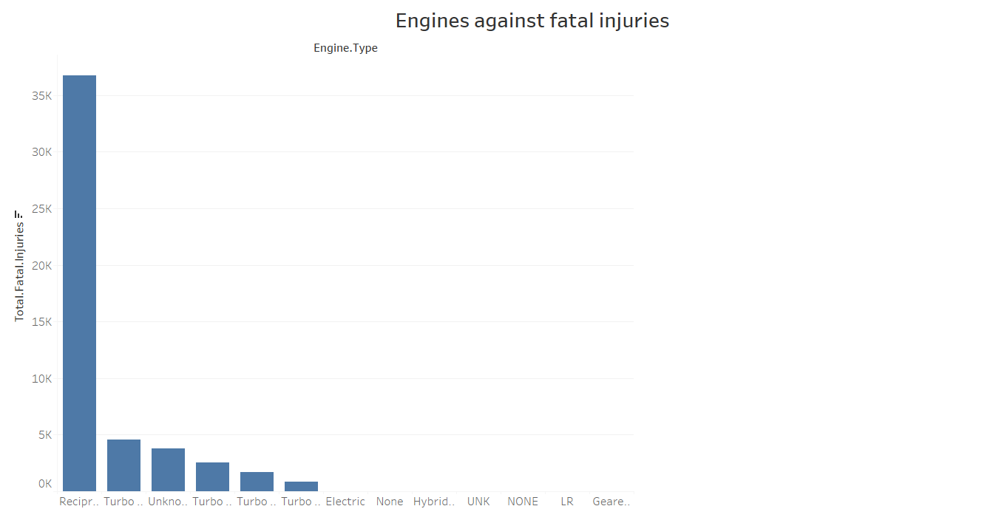
Safer
ENGINE TYPES
Which engine types are the safest in terms of fatality rates?
Turbo Prop and Turbo Shaft engines show lower fatality rates compared to Reciprocating engines.
Reciprocating engines have the highest number of fatal incidents but are the most commonly used.
Recommendation: Prioritize Turbo Prop and Turbo Shaft engines for commercial and high-risk operations. Limit the use of reciprocating engines unless additional safety measures are in place.

Slide 6
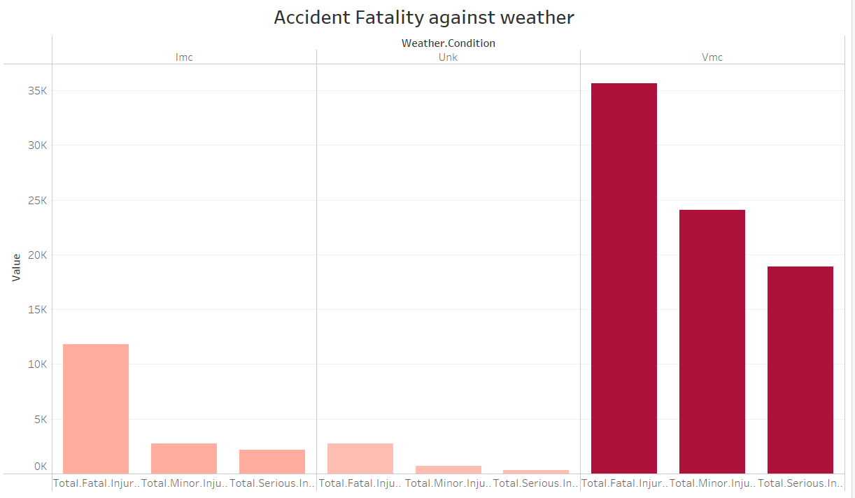
MANAGING WEATHER RISKS
Incidents in Instrument Meteorological Conditions (IMC) have higher fatality rates compared to Visual Meteorological Conditions (VMC).
Recommendation: Invest in advanced avionics like Enhanced Ground Proximity Warning Systems (EGPWS) and Terrain Awareness Warning Systems (TAWS) for safer navigation in poor weather.
Train pilots for challenging weather scenarios and enforce stricter flight delay protocols during adverse weather conditions.

Slide 7


What are the risks associated with amateur-built aircraft, and should they be used?
Amateur-built aircraft have a higher fatality rate (8.29%) compared to professionally-built aircraft (5.67%).
They are involved in fewer incidents overall, but when accidents occur, they are often more severe.
Limit the use of amateur-built aircraft for commercial operations and prioritize professional models for safety and reliability.

Slide 8
HOW DO REGIONAL TRENDS IN AIRCRAFT INCIDENTS INFLUENCE FLEET DECISIONS?
Regional Aircraft Incident Trends
The United States, Brazil, and Canada show high incident counts for certain models like Cessna 152, Piper PA-28, and Boeing 737.
Recommendation: Tailor fleet decisions based on regional safety trends and the performance of aircraft models in specific operating environments. Avoid models that have a poor safety track record in your target region.

Slide 9



Predictive Maintenance
How can predictive maintenance schedules reduce incident risks?
Recommendation: Implement predictive maintenance schedules, particularly for older aircraft or models with higher incident counts. Anticipating periods of higher risk can reduce the chance of accidents.
By analyzing incident trends over time, maintenance schedules can be adapted to prevent mechanical failures and mitigate risks.
10

Slide 10



HOW DOES WEATHER
AFFECT AIRCRAFT SAFETY, AND WHAT CAN BE DONE TO MITIGATE THIS?
Weather plays a crucial role in incident severity, especially under IMC conditions.
Recommendation: Enhance pilot training for adverse weather conditions, upgrade fleet avionics for better navigation, and adopt strict flight delay protocols during poor weather to mitigate risks.

Slide 11
What steps should be taken to reduce the risks associated with certain models and engines?
Regular Maintenance: Prioritize maintenance and safety upgrades for older or incident-prone models.
Pilot Training: Provide additional training for models frequently involved in incidents.
Upgrade Fleet: Retire or upgrade older aircraft models and replace high-risk engine types with safer alternatives.
Diversify Fleet: Avoid relying too heavily on one model or engine type to reduce operational risks.

Slide 12

THANK
YOU

